Slide 1
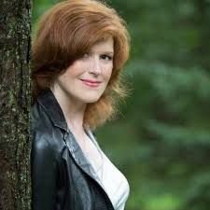


Virtual Author Visit- Joelle Charbonneau
When: Wednesday, March 25th
Time: 11:00
Where: Microsoft Teams
Who: All are welcome
Your English teacher will share the Link with you

